Slide 1
PROJECT 1 · MACHINE LEARNING
Predicting LendingClub
Loan Interest Rates
Application-time prediction of int_rate — exploratory analysis, model comparison, and explainability on 100,000 loans.
100,000 LOANS · 38 FEATURES · BEST RMSE 3.87
[Course / Section] Group SAXA 8
[Team member names]

Slide 2
CONTEXT · PROBLEM FRAMING
Context & Problem
Estimate the interest rate a LendingClub loan would be offered, using only information available at the moment of application.
PROBLEM STATEMENT
ASSUMPTIONS & GUARDRAILS
Predict int_rate (loan APR, %) for 10,000 held-out applications and minimize test-set RMSE.
Target ranges 6.46–30.99%, mean 12.95, right-skewed (skew 0.85).
Pure regression on tabular application data — no time series, no text scoring.
loan_status is post-origination leakage and is dropped before any modeling.
grade / sub_grade / installment are absent from this slice — no shortcut to APR.
No date columns exist, so validation uses a random 80/20 split, not a temporal one.
DATASET AT A GLANCE
100,000
10,000
38
6.46–31%
12.95%
Training loans
Test loans
Model features
Target range
Mean rate
02

Slide 3
METHODOLOGY · PREPARING THE DATA
Turning Applications Into Useful Signals
We translate each raw loan application into 36 consistent, comparable measures — applied the same way to every applicant, and never using the answer we are trying to predict.
01 · CLEAN UP
02 · BUILD MEASURES
03 · STRESS-TEST
Fix data quirks; remove unfair hints
36 clear, comparable indicators
Checked on applicants it never saw
6
Credit strength
5
Can they afford it?
8
Risk groupings
Credit score, score tier, and loan length
Loan size and debt compared to income
Debt and credit-use tiers; extreme values smoothed
A cleaner read on each borrower
Weighs borrowing against earnings
Sorts borrowers; tames outliers
6
Combined effects
7
Credit history gaps
4
Location & purpose
How score, debt, and loan length work together
Past issues, credit-file age, missing records
Home state, ZIP region, and reason for the loan
Catches risk visible only in combination
Treats what is missing as meaningful
Adds local patterns without unfair hints
Safeguards: We remove anything that would not be known when someone applies, and every measure is built without using the outcome — so the results stay fair and trustworthy.
03

Slide 4
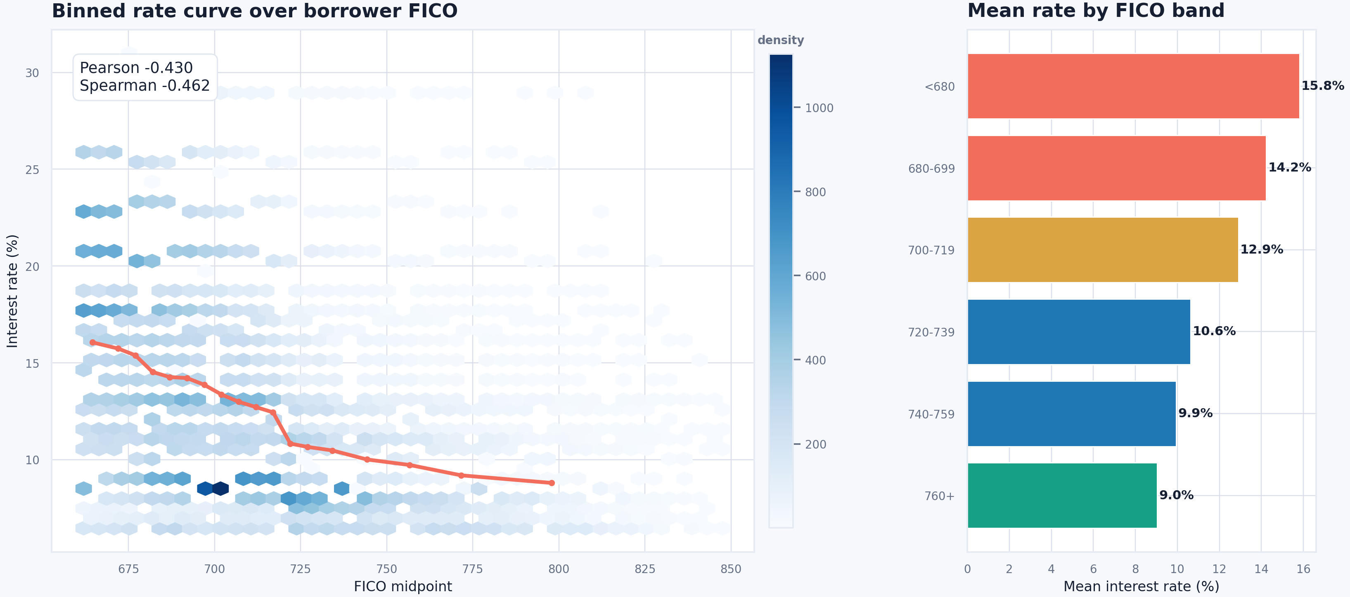
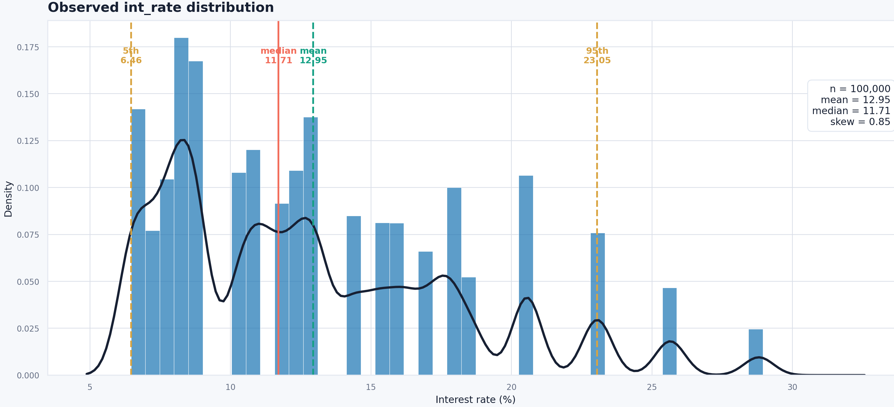
ANALYSIS · EXPLORATORY DATA ANALYSIS
What the Data Says
FICO is the dominant application-time signal; utilization, DTI and loan term carry most of the remaining recoverable variance.
KEY FINDINGS
FICO vs INTEREST RATE
FICO ↔ rate: Spearman −0.46 — higher score, lower APR.
Utilization next: all_util +0.33, revol_util +0.30; DTI +0.18.
60-month term and small-business / educational purposes price higher.
mths_since_last_record is 90.9% missing — "no record" is signal.
Test loans are smaller (loan_amnt PSI 0.17), slightly higher FICO.
TARGET DISTRIBUTION
04

Slide 5
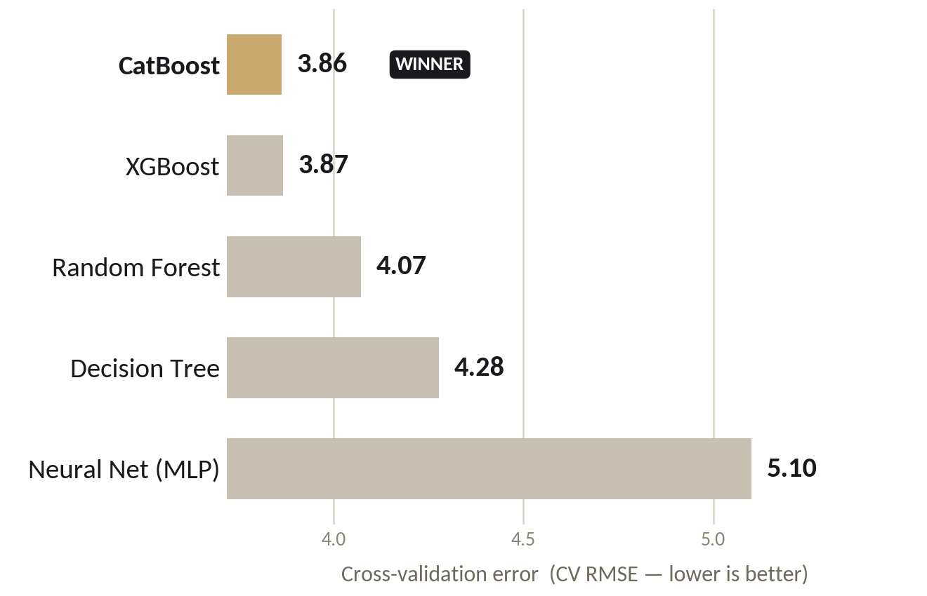
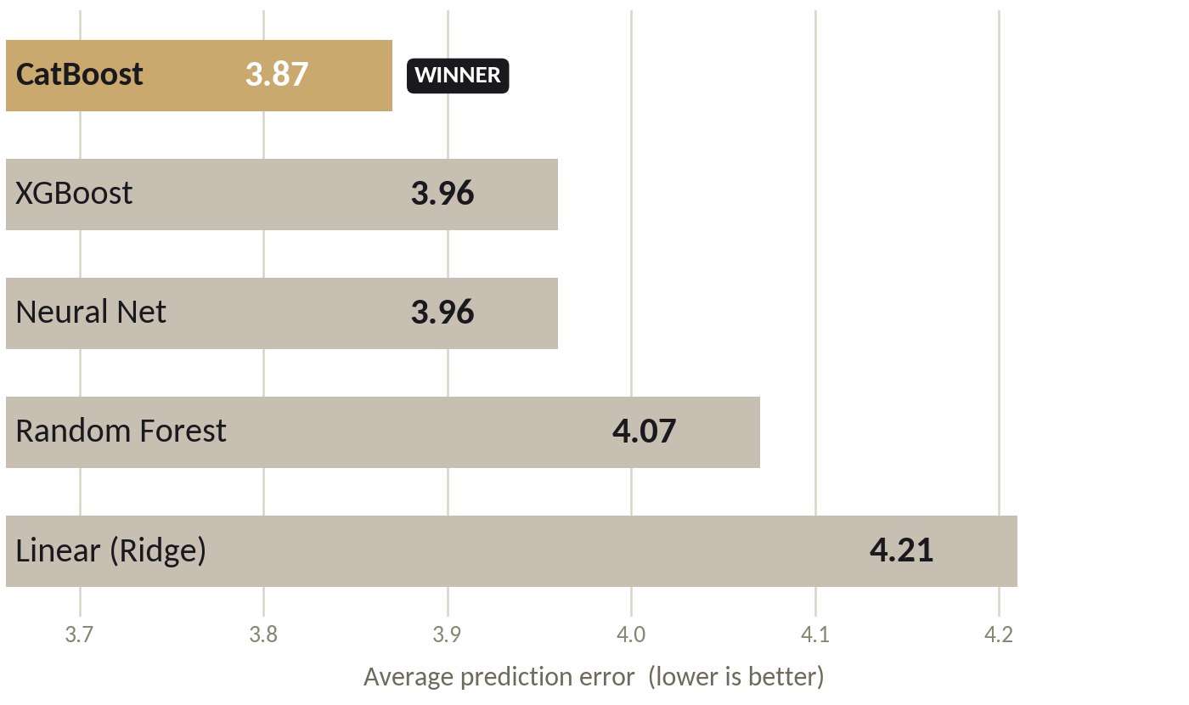
MODELING · COMPARISON
Five Models, One Winner
All five models were trained on the same data and the same 80/20 split. Cross-validation error (CV RMSE) is the one score recorded for every model — CatBoost posts the lowest and is the model we submitted.
Model | CV RMSE | Val RMSE | Val MAE | Val R²
Decision Tree | 4.2781 | — | — | —
Random Forest | 4.0723 | 4.019 | 3.007 | 0.410
XGBoost | 3.867 | — | 2.955 | —
Neural Net (MLP) | 5.101 | — | — | 0.06
CatBoost (final) | 3.863 | 3.872 | 2.902 | 0.465
✓ CatBoost edges XGBoost and its cross-check (3.86) matches the hold-out (3.87) — not overfit.
— = metric not recorded for that model.
05

Slide 6
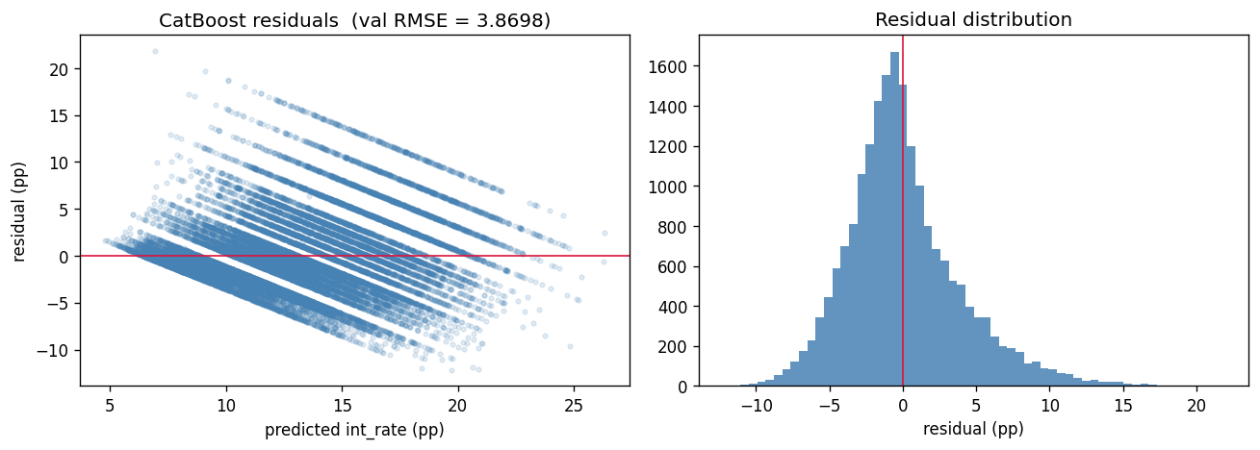
MODELING · FINAL MODEL
Final Model: CatBoost
Gradient-boosted trees with native categorical handling; 5-fold per-fold target encoding gives an honest cross-validated estimate that matches the holdout.
HELD-OUT PERFORMANCE (20%)
RESIDUAL DIAGNOSTICS
3.863
3.872
OOF RMSE (CV)
Validation RMSE
2.902
0.465
Validation MAE
Validation R²
TUNED HYPERPARAMETERS
OOF RMSE (3.863) and holdout RMSE (3.872) agree closely — the model is well-calibrated and not over-fit. R² of 0.465 reflects the dataset's real ceiling without grade / sub-grade.
Hyperparameter | Value
Learning rate | 0.03
Tree depth | 7
L2 regularization | 5.0
Random strength | 1.0
Bagging temperature | 0.5
Border count | 200
Max iterations | 2,500 (early stop @ 100)
Predicted-rate range | 6% – 31%
06

Slide 7
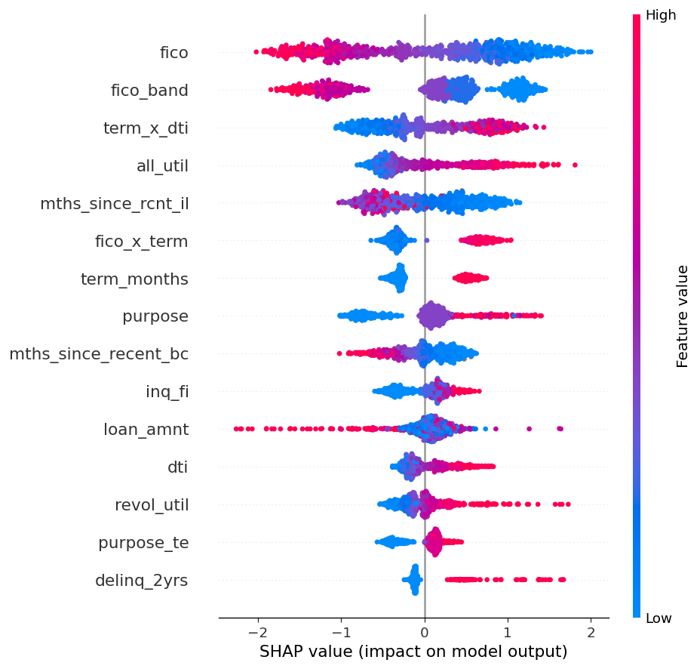
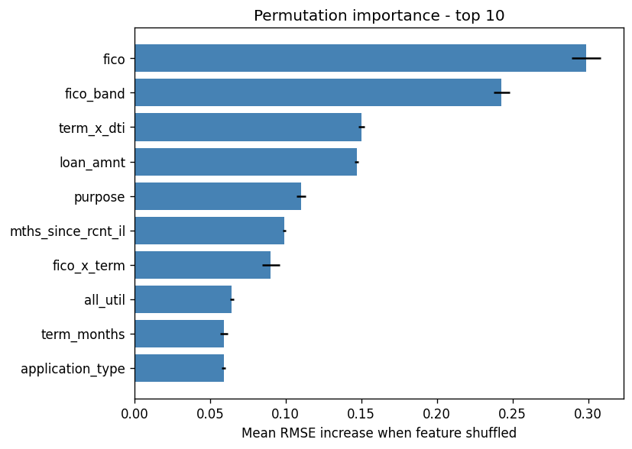
INSIGHTS · EXPLAINABILITY
Why the Model Decides
Two techniques agree with the EDA: SHAP values and permutation importance both rank credit quality, loan structure and utilization at the top.
SHAP SUMMARY
PERMUTATION IMPORTANCE
BUSINESS INSIGHTS
FICO dominates — a strong score is the single biggest lever on the offered rate.
Loan structure (term × DTI, loan_amnt) is the next driver of pricing.
Utilization & recent credit activity push rates up at the margin.
Same drivers across SHAP, permutation & gain — the model is trustworthy.
07

Slide 8
CONCLUSION · REFLECTION
Conclusion & Reflection
The model estimates the interest rate a new applicant would be offered — accurately, dependably, and for understandable reasons.
± 3.9 pts
Typical error when estimating a loan’s rate
47%
Of the differences in rates the model explains
Consistent
Same accuracy on new loans as in testing
WHAT THIS MEANS
WHAT WE LEARNED
Instant, consistent pricing. The rate a borrower qualifies for is estimated the moment they apply — every applicant judged by the same standard.
Dependable in the real world. It is just as accurate on new applicants as in testing, so the results can be trusted for real decisions.
Transparent by design. It weighs the same signals a seasoned underwriter would — credit strength, loan size, and borrowing habits — so every estimate can be explained.
Clean data beats clever models. Getting the inputs right delivered more than any added complexity ever could.
Honest testing builds confidence. We measured the model only on data it had never seen — so the accuracy is real, not optimistic.
We know the ceiling. About 47% is the realistic limit for this data; reaching it is the goal met, not a shortfall.
Final model: CatBoost — tuned for accuracy, with every prediction kept within the realistic 6%–31% rate range.
08

Slide 9
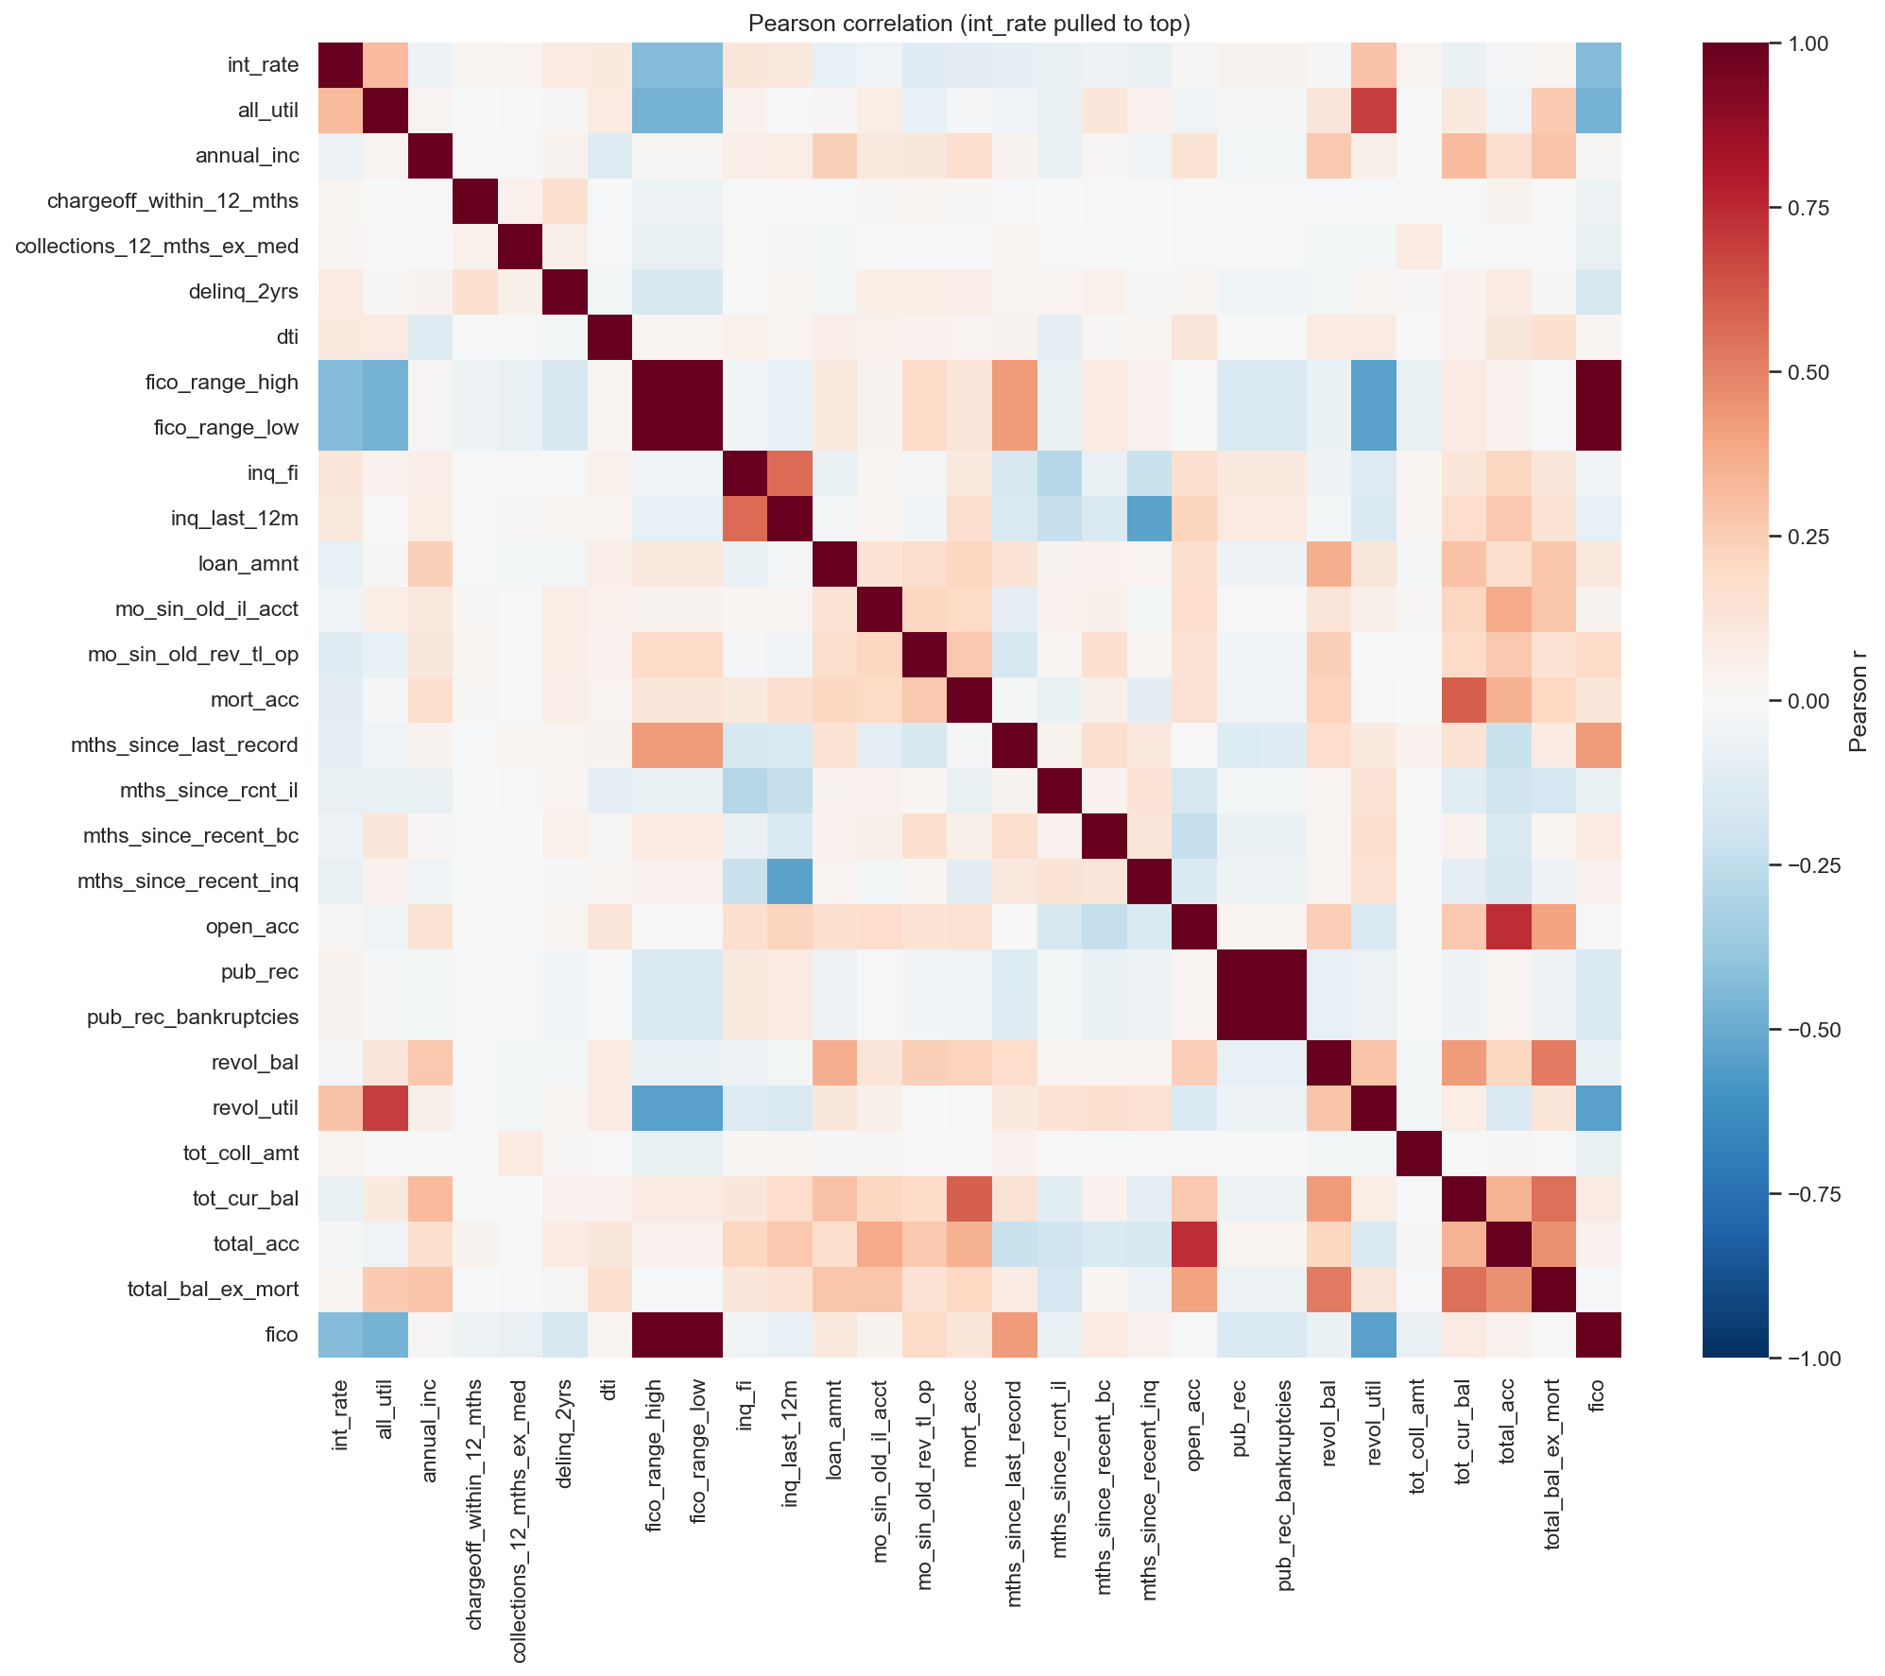
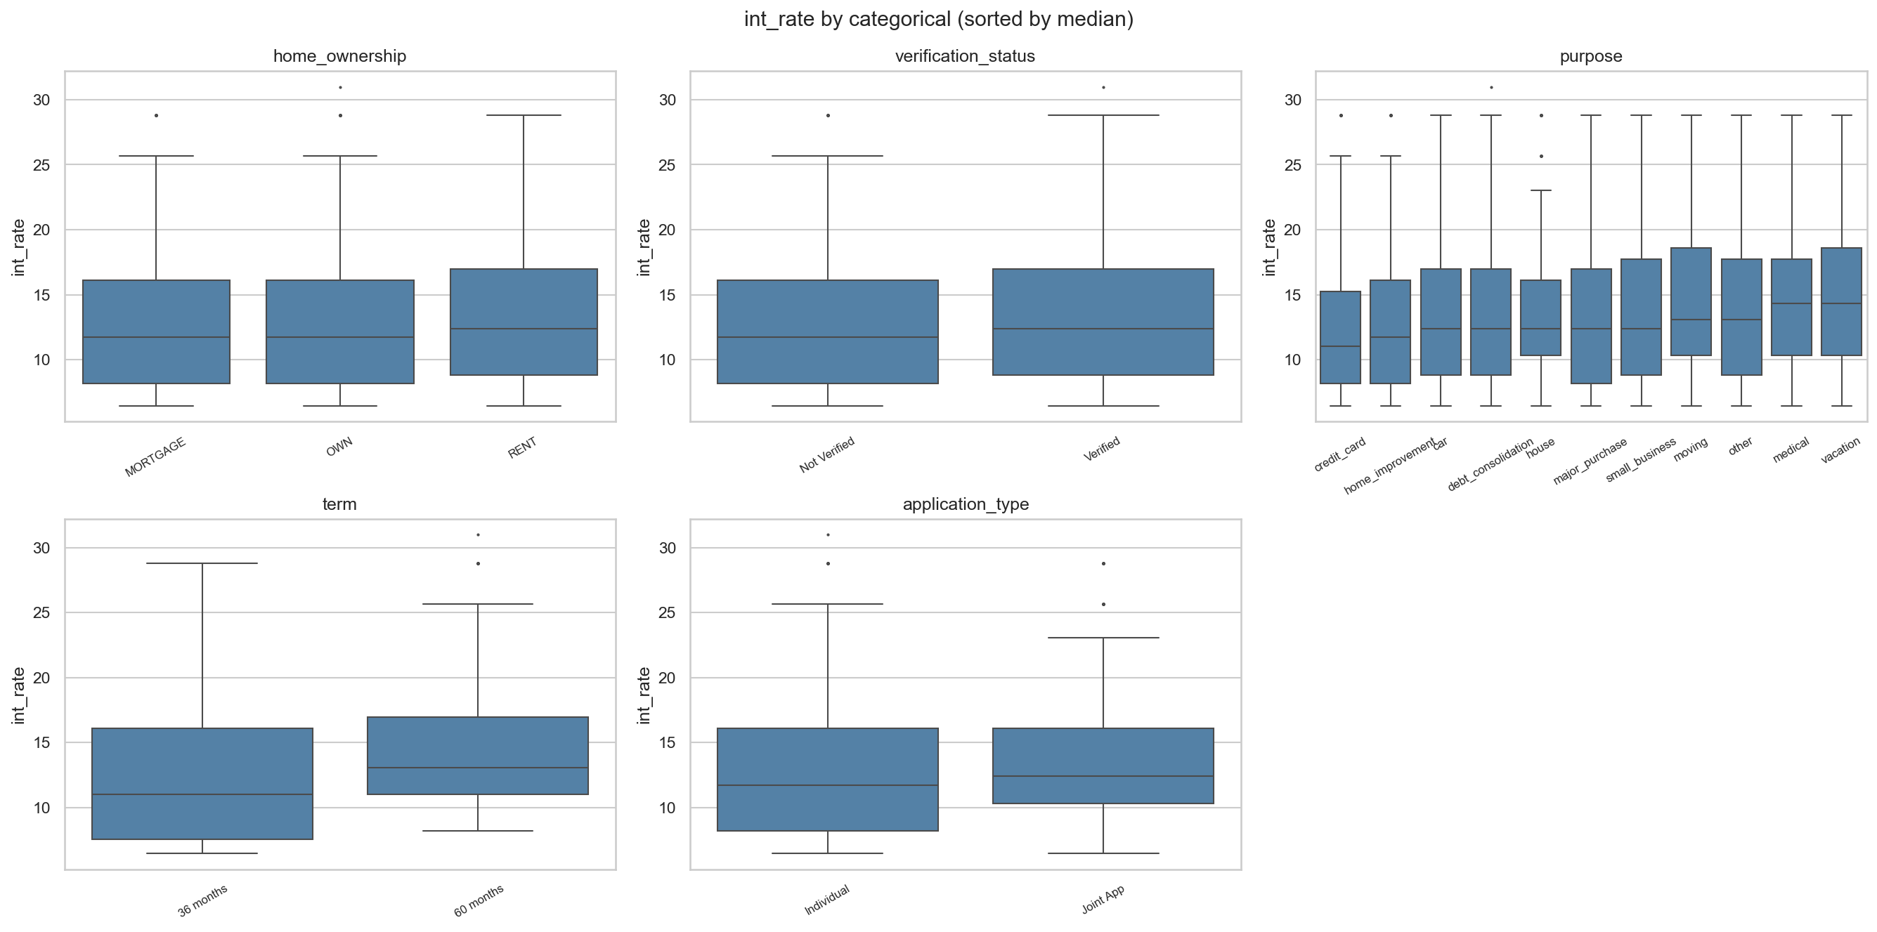
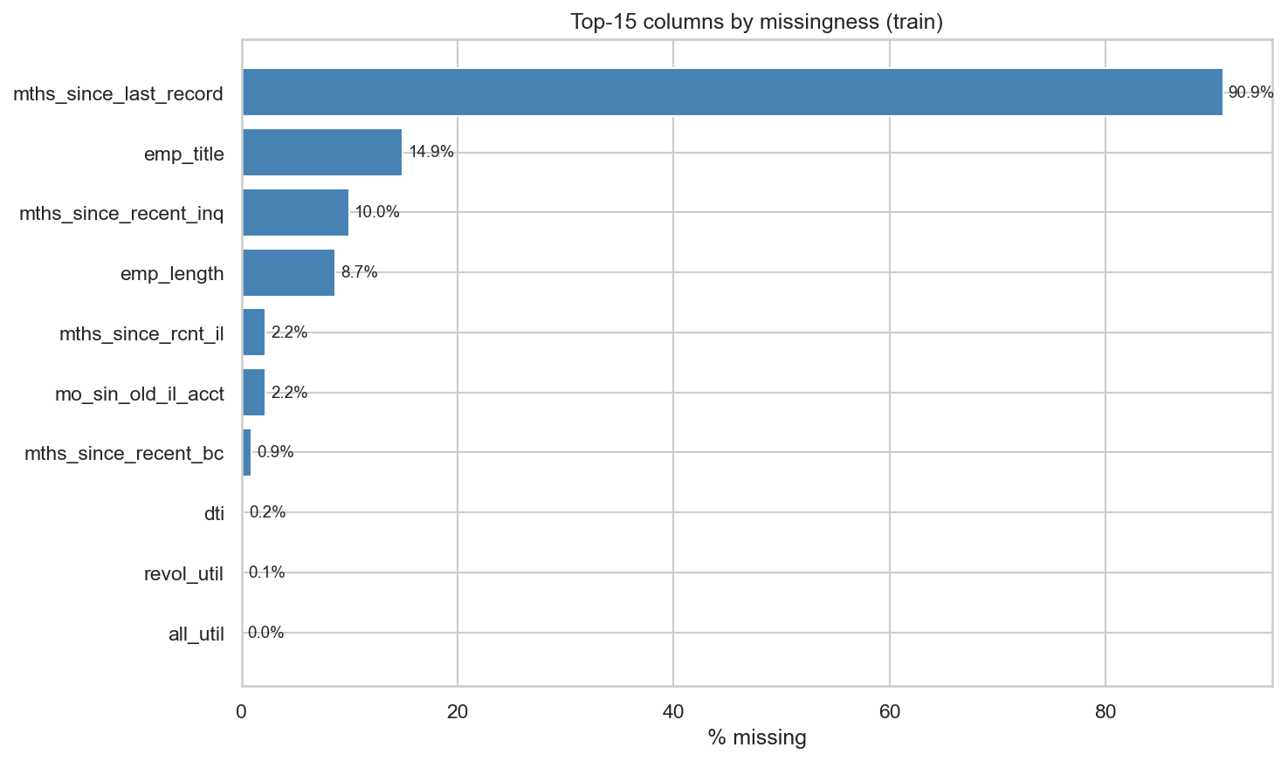
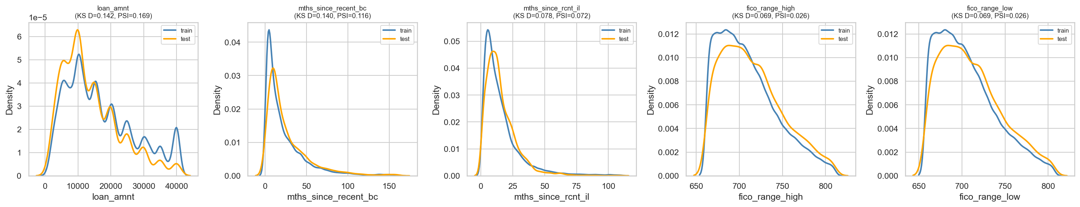
APPENDIX A
EDA Exhibits
CORRELATION STRUCTURE
RATE BY CATEGORY
MISSINGNESS (TOP COLUMNS)
TRAIN vs TEST DRIFT
09

Slide 10
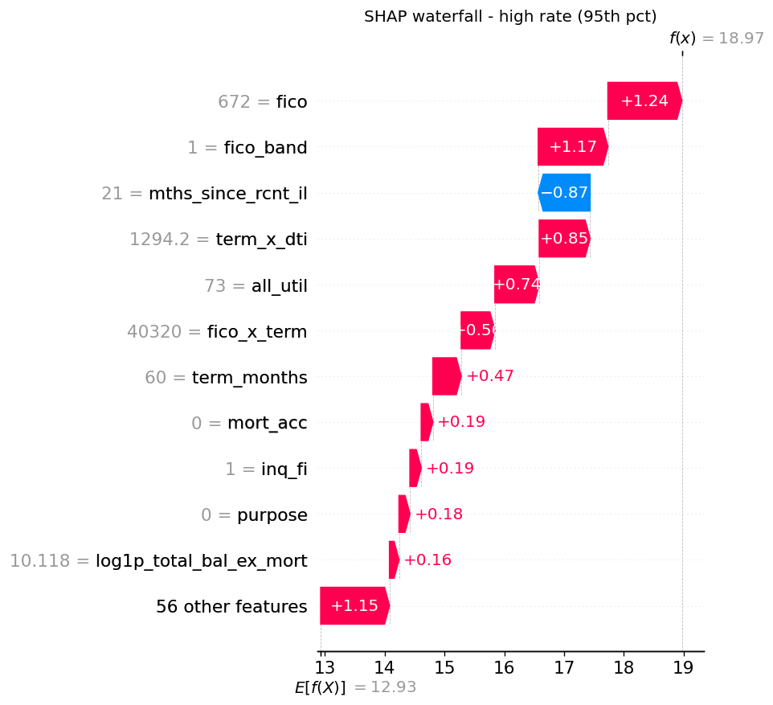
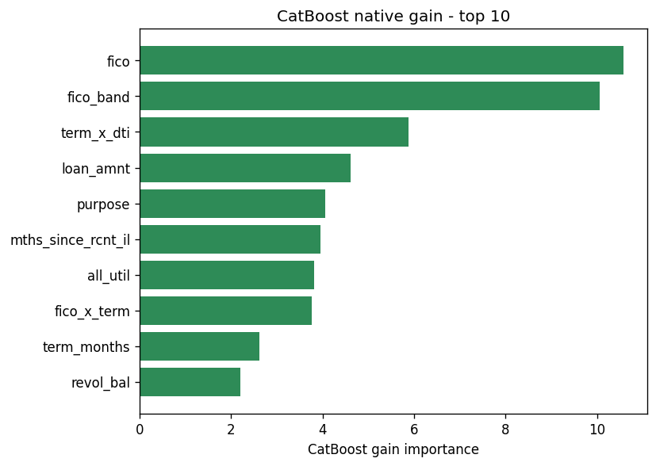
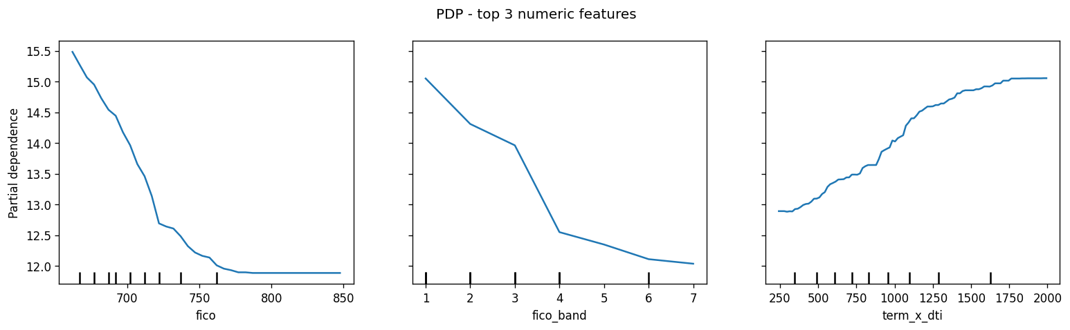
APPENDIX B
Explainability Exhibits
SHAP WATERFALL (HIGH-RATE LOAN)
CATBOOST GAIN (TOP 10)
PARTIAL DEPENDENCE (TOP 3)
10

Slide 11

ACKNOWLEDGEMENTS · GROUP SAXA 8
11

